Slide 1
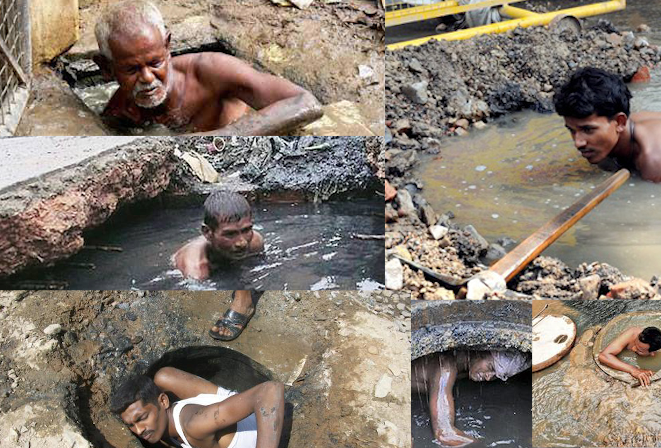
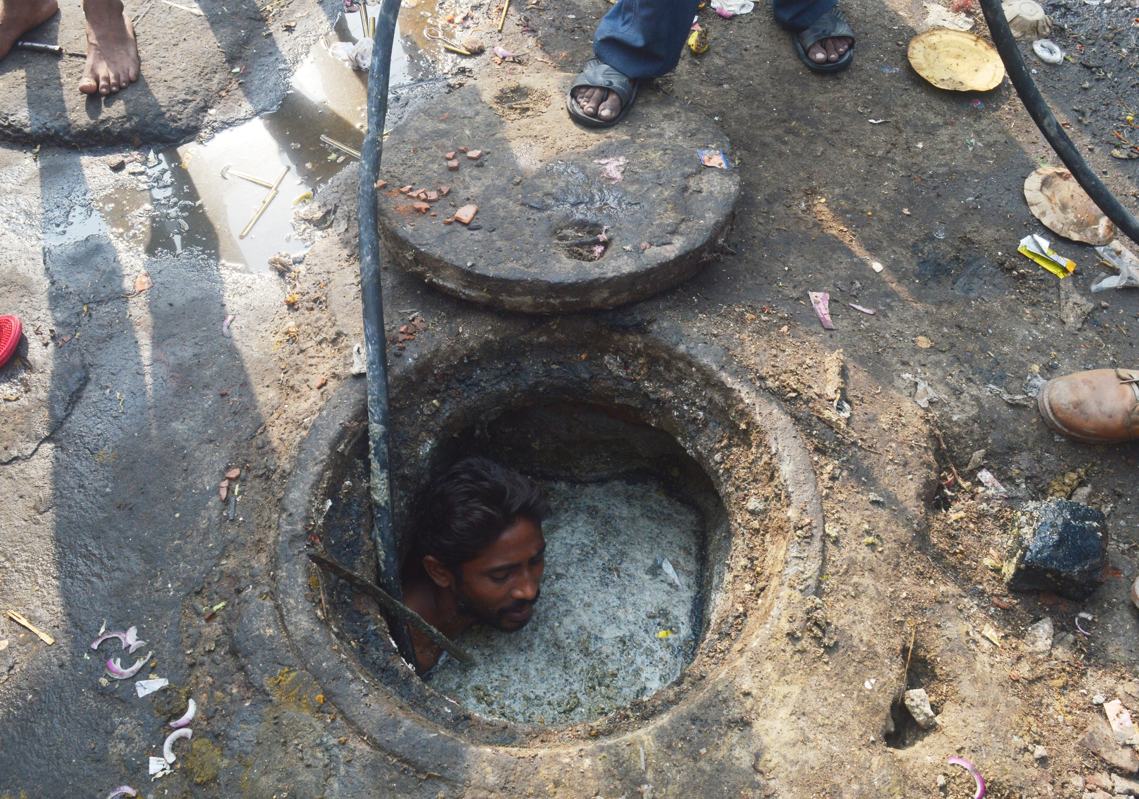
Wast-e-prenuers
“Revolution where we need it the most”

Slide 2
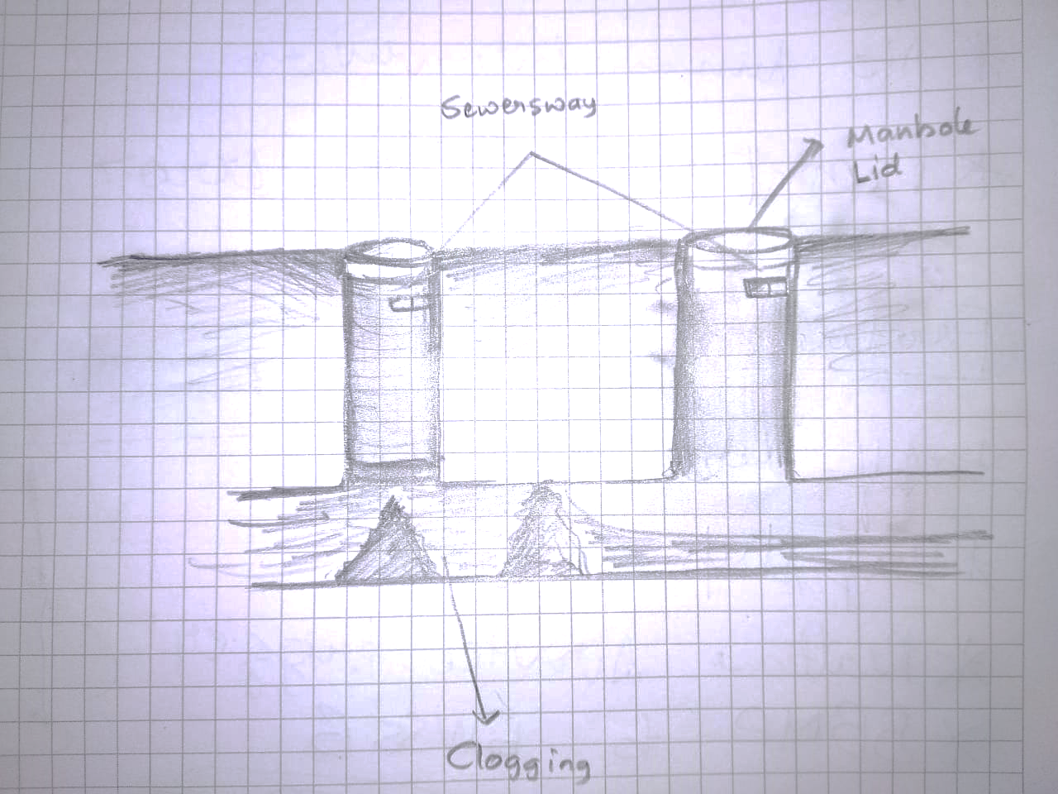
Problem statement
Current process of sewer line cleaning is reactive.
Difficult for manual scavengers to zero-in on the point of error.
Need for technological advancements in the field of manual scavenging.

Slide 3



Existing solution
Customer raises a complaint
Hit and trial analysis of the problem
Action
No such technology available throughout India. Currently only manual methods are used.

Slide 4
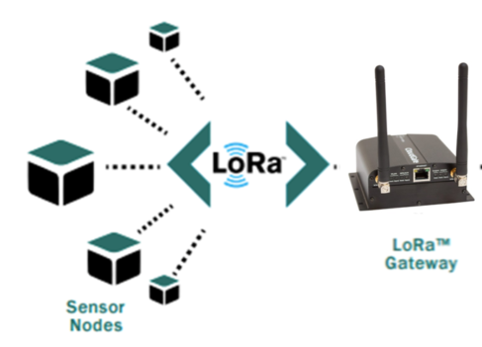
Solution – Sewer’Sway*
Sewer’Sway is a Modular device that uses LoRa for communication and thereby establishing a mesh network that allows authorities to have a Real-time map of the drainage system in any city or area.
*pun intended

Slide 5
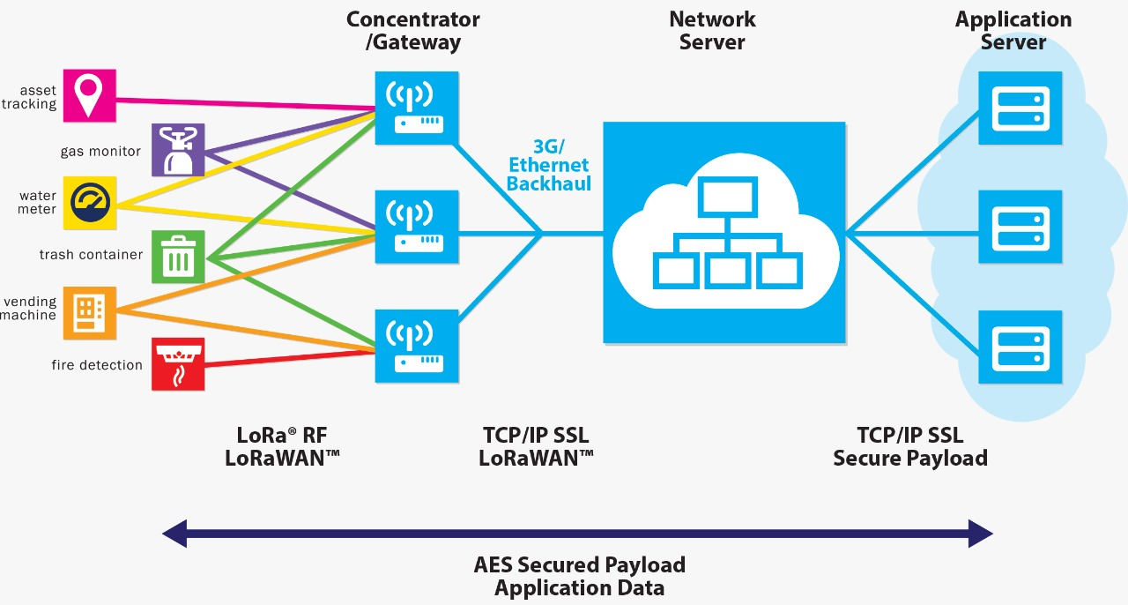

Slide 6
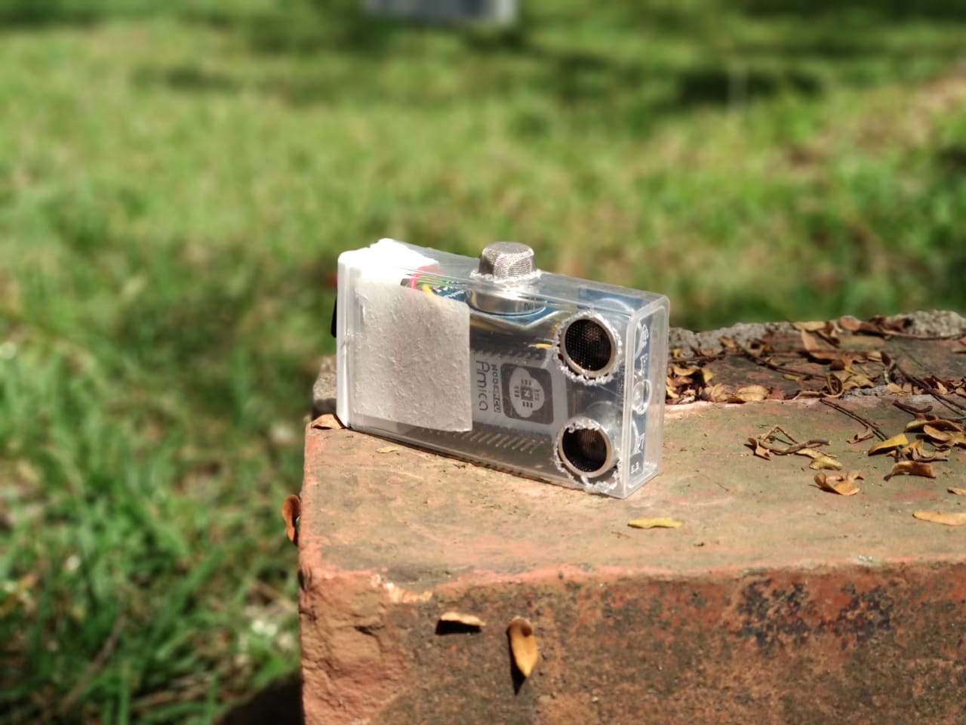
Sewer’Sway

Slide 7
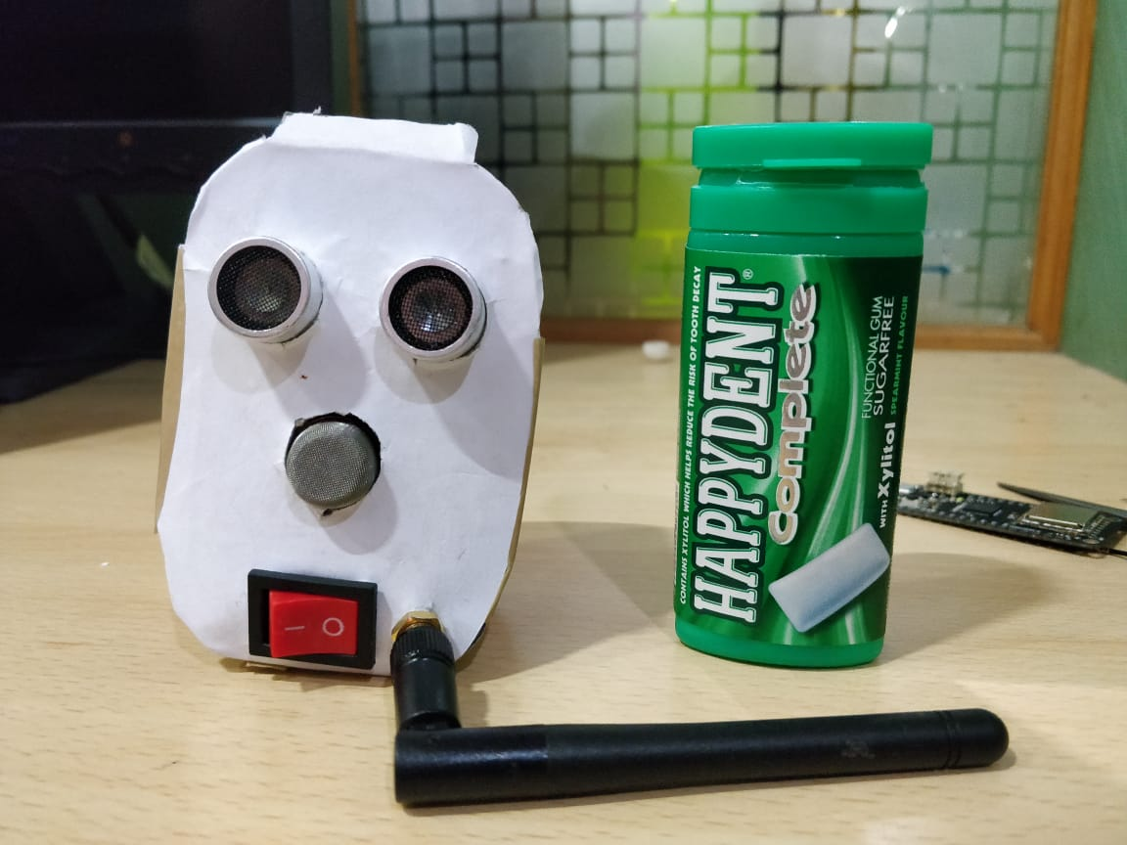
Sewer’Sway

Slide 8
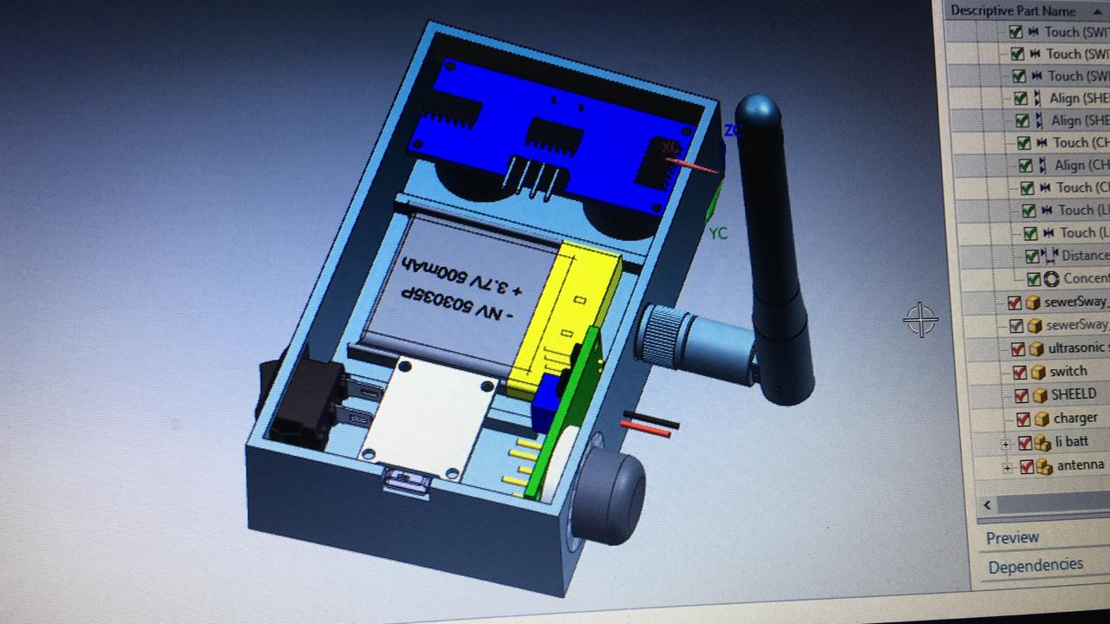
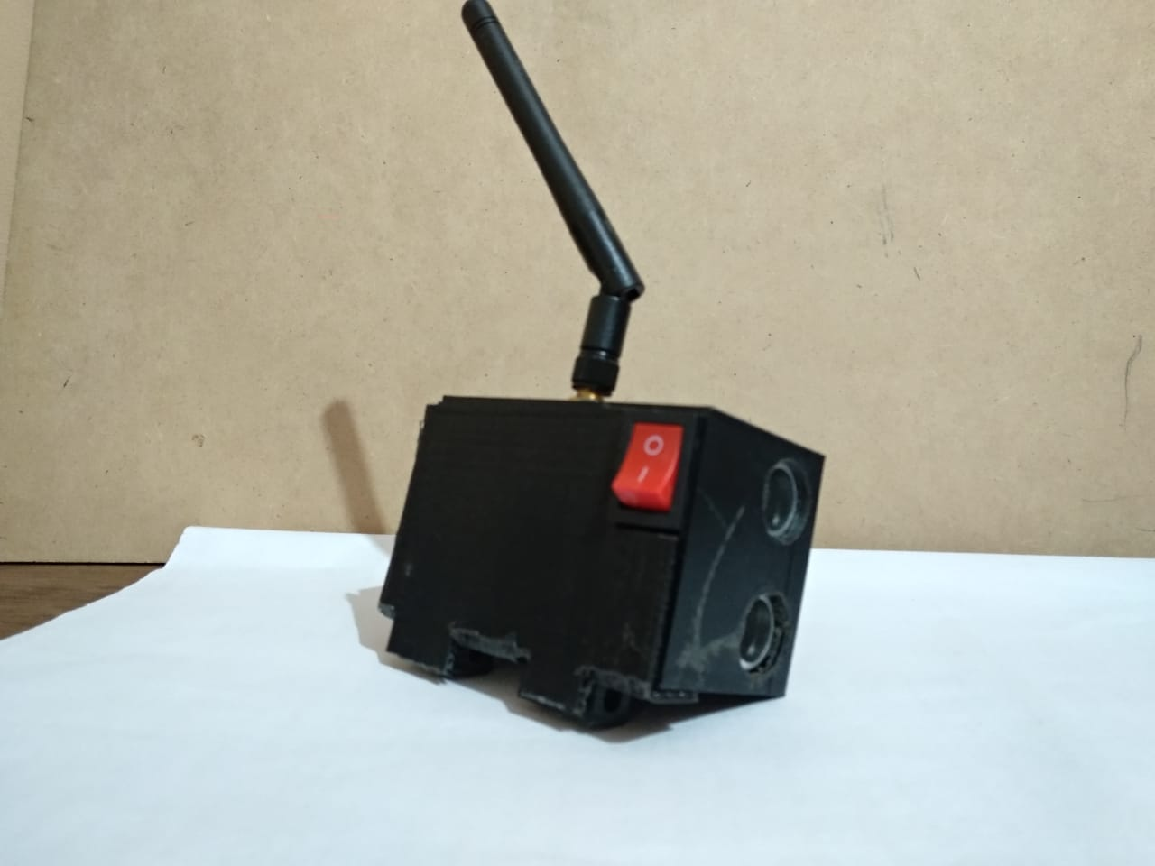
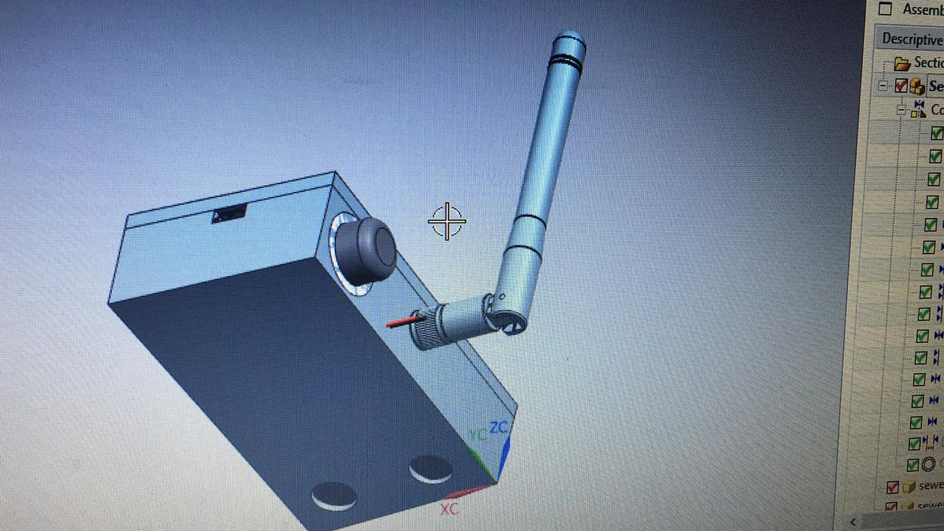
Sewer’Sway

Slide 9
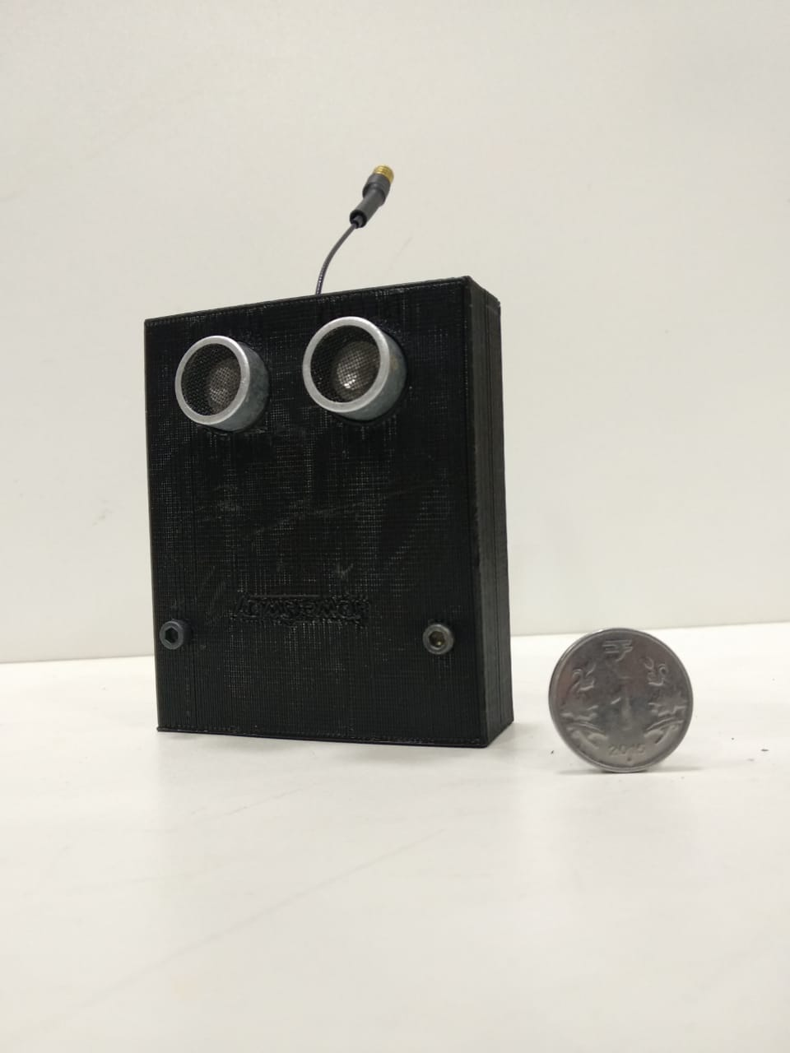
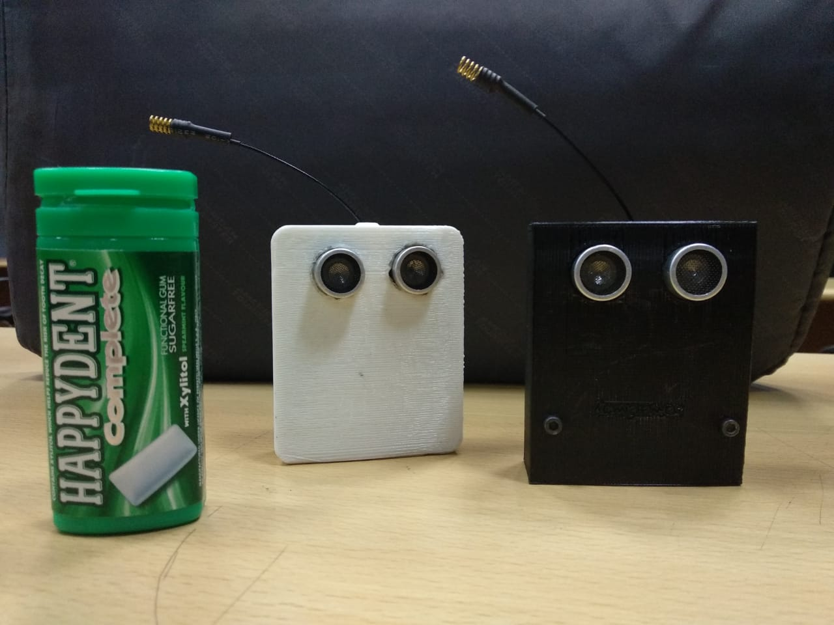
Sewer’Sway

Slide 10
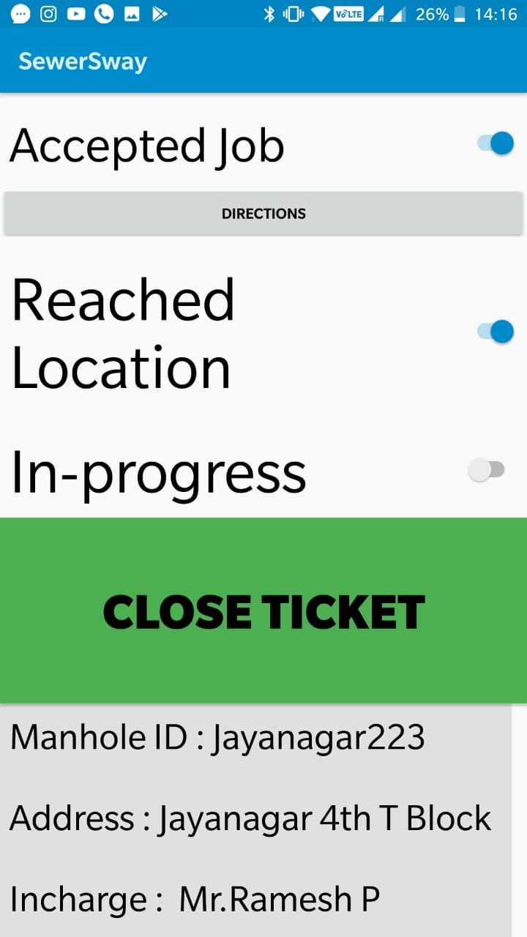
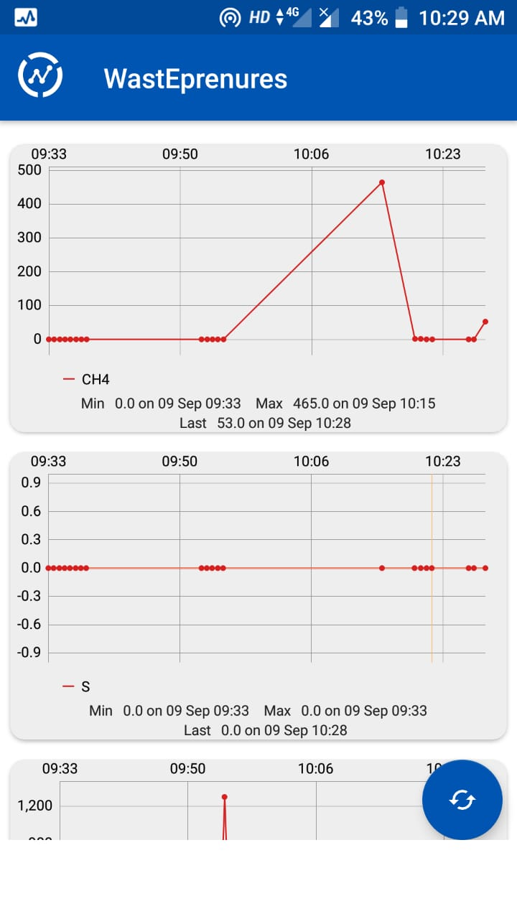
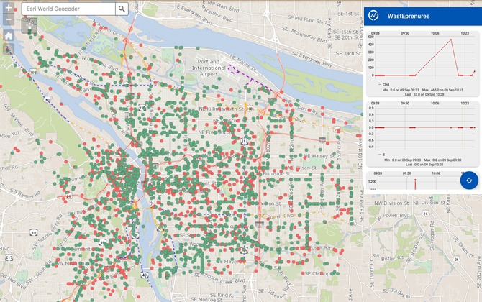
Real time mapping

Slide 11

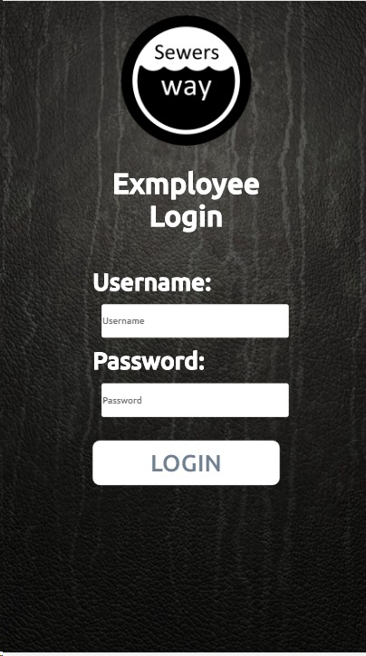


Slide 12
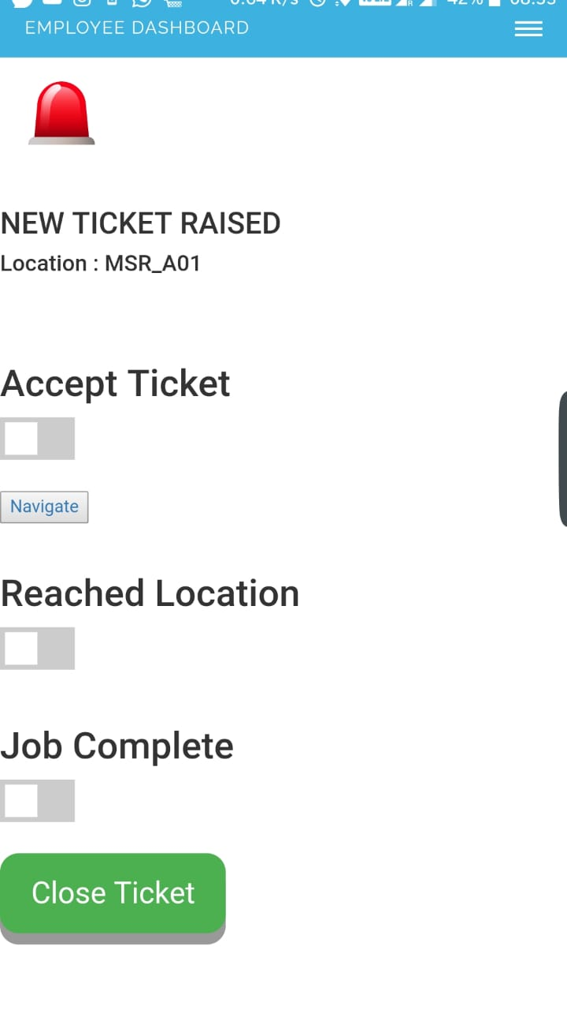
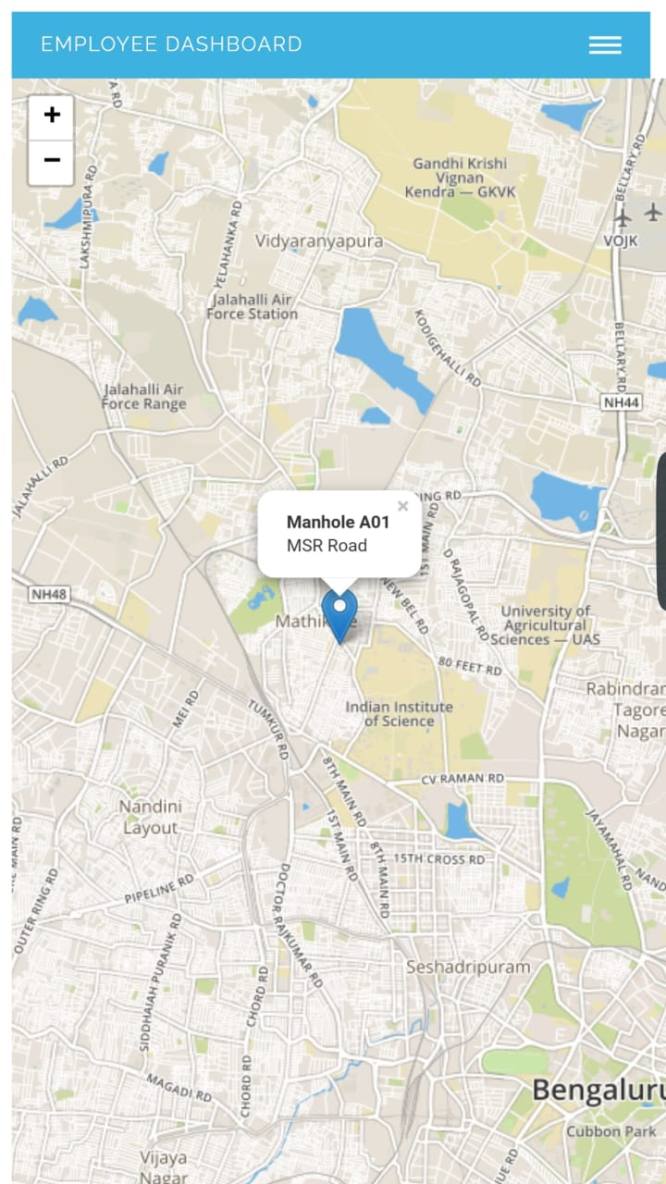
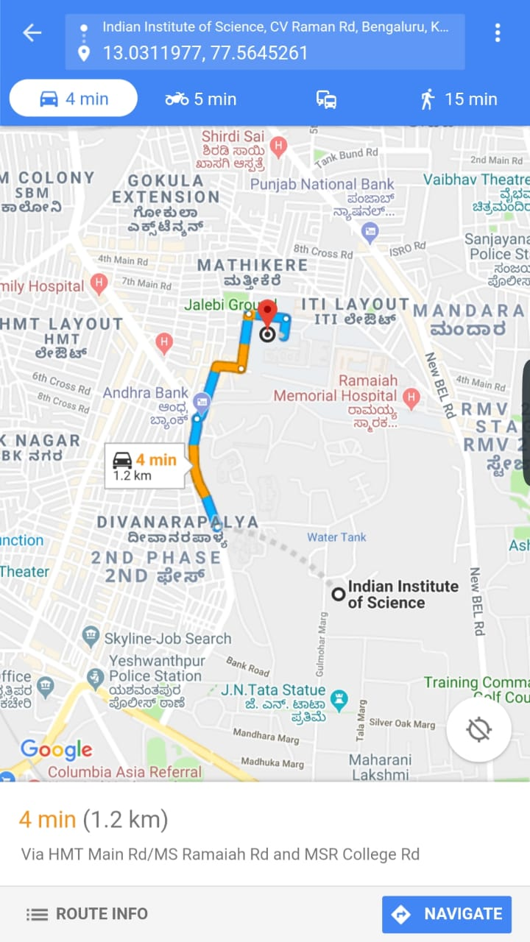

Slide 13
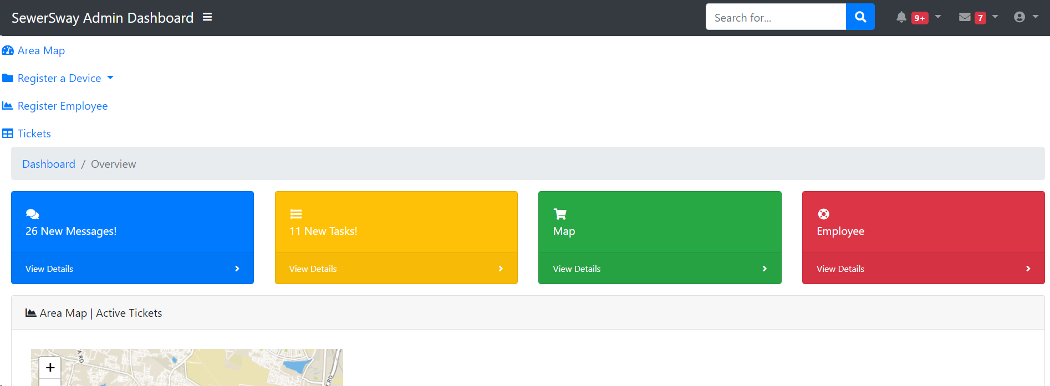

Slide 14
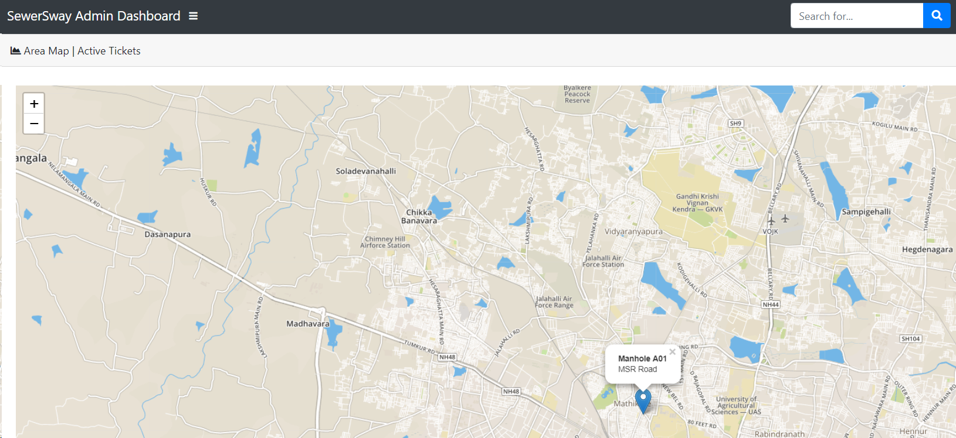

Slide 15
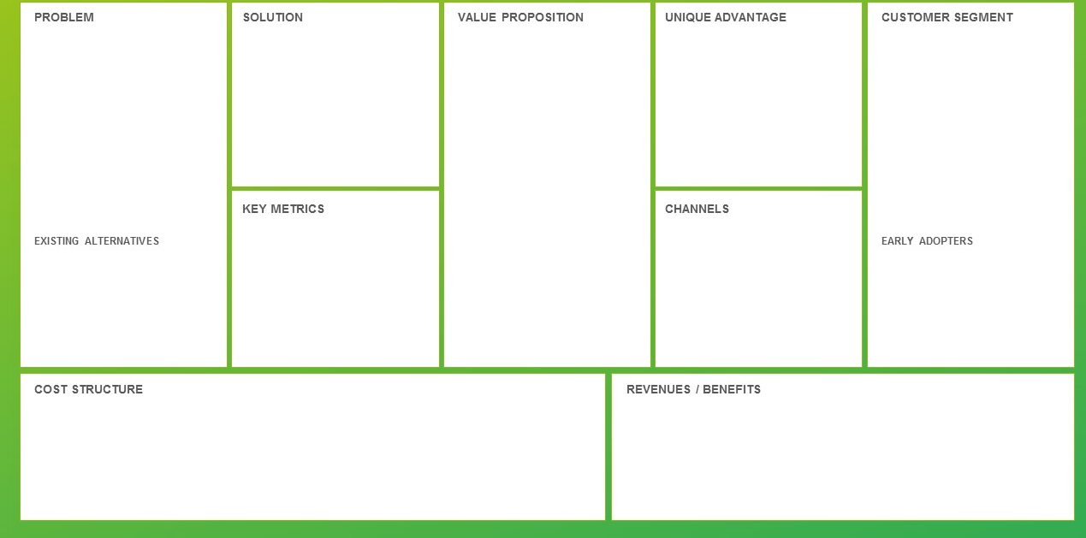
Business Plan
Prevention is better than cure
- Required human intervention
- pin-point error
- delayed response time
-Modular
-LoRa
-Real-time map
-Compatible with existing infrastructure
-Proactive and preventive
-Saving lives, powered by technology
-Crime against humanity, injustice to manual scavengers
-deep sleep mode that allows our module to run for more than 2 years. -Real time services that allows detection of clogged areas -Feedback system to the BBMP authorities who can work hand in hand with BWSSB
1) Municipal corporation of each city 2) Private builders and housing societies
1) % concentration (ppm) 2) water level 3) No. of manholes in the database
4) No. of tickets/compliants
Multi-channel eCommerce & Marketplaces (B2B):
Service-based : As a timely subscription based service
Product-based : As a one-time purchase product
None, only manual methods are used.
People: Yes; Saving time on manual responses and decrease the .
Profit: Yes; established network of millions in the country. Adoption by each state multiples the subscriptions and services.
-MVP’s cost including industrial coating and packaging to be less than $15, targeting a selling price of $30.
-Subscription model for quarterly, half-yearly and annual services.

Slide 16

Scalability
Deploy Hosting
Register Devices
Employee Registration
App Hosting are docker container compatible which gives great deployment-scalability
Registration of devices into the hosted system is automated through RPA
Finally, each employee can be registered for their respective areas and device(s)

Slide 17
What’s Next
Industrial/Site survey
Inspection of manholes and feasibility of placing the product. Estimation of water levels, material of manhole(concrete)
More Prototyping
Test trials
Demo inside campus.
building database
Testing in simulated environment, Failure mode effect analysis (FMEA), durability, fitness etc.

